Slide 1
CISE301: Numerical Methods
Topic 2:
Solution of Nonlinear Equations
Lectures 5-11:
KFUPM
Read Chapters 5 and 6 of the textbook
CISE301_Topic2
KFUPM

Slide 2
Lecture 5
Solution of Nonlinear Equations
( Root Finding Problems )
  Definitions
  Classification of Methods
    Analytical Solutions
    Graphical Methods
    Numerical Methods
      Bracketing Methods
      Open Methods
  Convergence Notations
  Reading Assignment: Sections 5.1 and 5.2
CISE301_Topic2
KFUPM

Slide 3
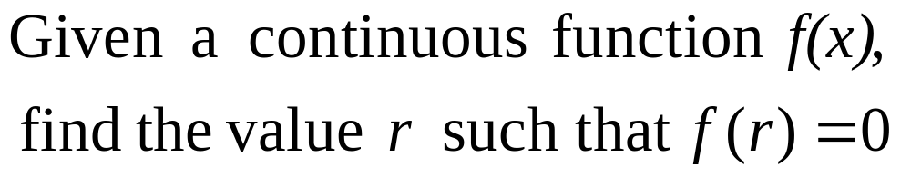
Root Finding Problems
Many problems in Science and Engineering are expressed as:
These problems are called root finding problems.
CISE301_Topic2
KFUPM

Slide 4
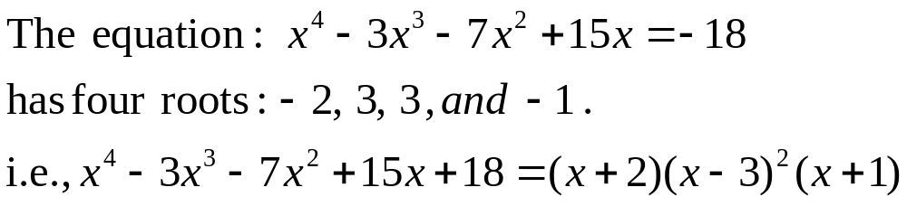
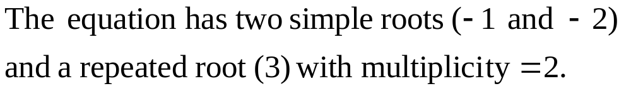
Roots of Equations
A number r that satisfies an equation is called a root of the equation.
CISE301_Topic2
KFUPM

Slide 5
Zeros of a Function
Let f(x) be a real-valued function of a real variable. Any number r for which f(r)=0 is called a zero of the function.
Examples:
2 and 3 are zeros of the function f(x) = (x-2)(x-3).
CISE301_Topic2
KFUPM

Slide 6
Graphical Interpretation of Zeros
The real zeros of a function f(x) are the values of x at which the graph of the function crosses (or touches) the x-axis.
f(x)
Real zeros of f(x)
CISE301_Topic2
KFUPM

Slide 7

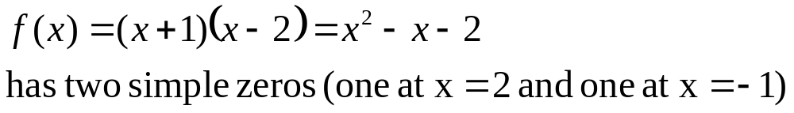
Simple Zeros
CISE301_Topic2
KFUPM

Slide 8

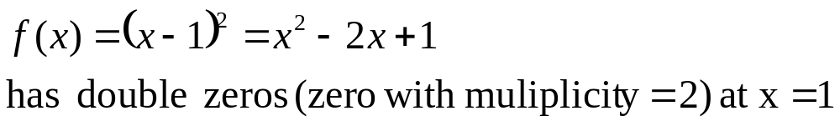
Multiple Zeros
CISE301_Topic2
KFUPM

Slide 9

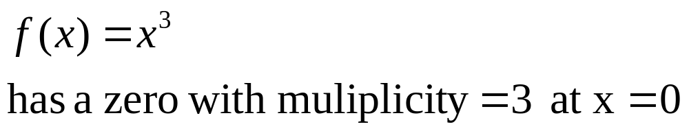
Multiple Zeros
CISE301_Topic2
KFUPM

Slide 10
Facts
Any n^{th} order polynomial has exactly n zeros (counting real and complex zeros with their multiplicities).
Any polynomial with an odd order has at least one real zero.
If a function has a zero at x=r with multiplicity m then the function and its first (m-1) derivatives are zero at x=r and the m^{th} derivative at r is not zero.
CISE301_Topic2
KFUPM

Slide 11
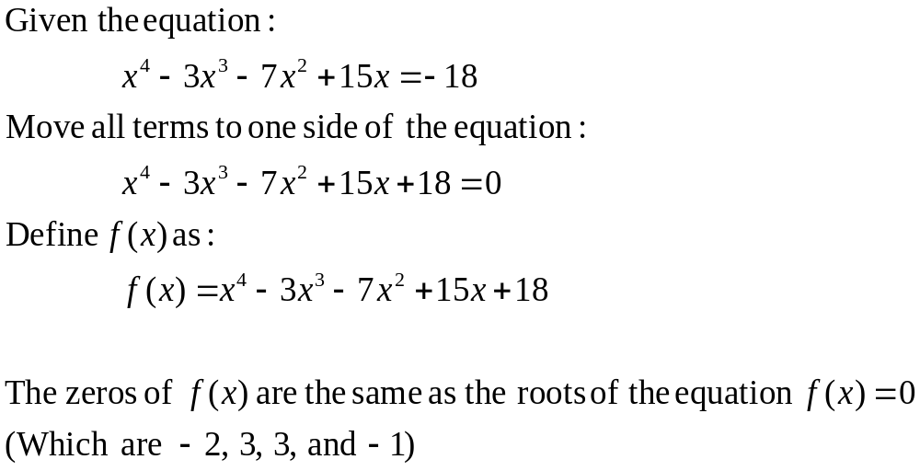
Roots of Equations & Zeros of Function
CISE301_Topic2
KFUPM

Slide 12
Solution Methods
Several ways to solve nonlinear equations are possible:
  Analytical Solutions
    Possible for special equations only
  Graphical Solutions
    Useful for providing initial guesses for other methods
  Numerical Solutions
    Open methods
    Bracketing methods
CISE301_Topic2
KFUPM

Slide 13
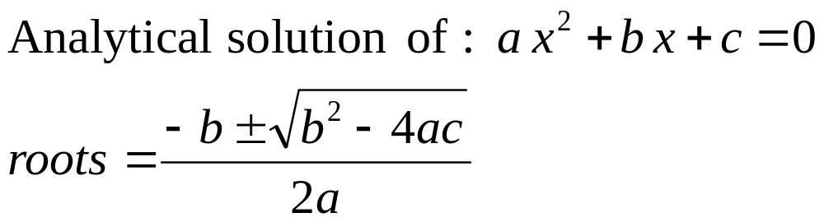
Analytical Methods
Analytical Solutions are available for special equations only.
CISE301_Topic2
KFUPM

Slide 14
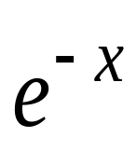
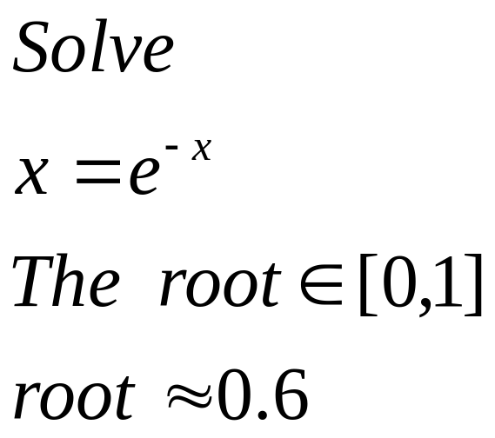

Graphical Methods
Graphical methods are useful to provide an initial guess to be used by other methods.
Root
2
1
1 2
CISE301_Topic2
KFUPM

Slide 15
Numerical Methods
Many methods are available to solve nonlinear equations:
  Bisection Method
  Newton’s Method
  Secant Method
  False position Method
  Muller’s Method
  Bairstow’s Method
  Fixed point iterations
  ……….
These will be covered in CISE301
CISE301_Topic2
KFUPM

Slide 16
Bracketing Methods
In bracketing methods, the method starts with an interval that contains the root and a procedure is used to obtain a smaller interval containing the root.
Examples of bracketing methods:
  Bisection method
  False position method
CISE301_Topic2
KFUPM

Slide 17
Open Methods
In the open methods, the method starts with one or more initial guess points. In each iteration, a new guess of the root is obtained.
Open methods are usually more efficient than bracketing methods.
They may not converge to a root.
CISE301_Topic2
KFUPM

Slide 18
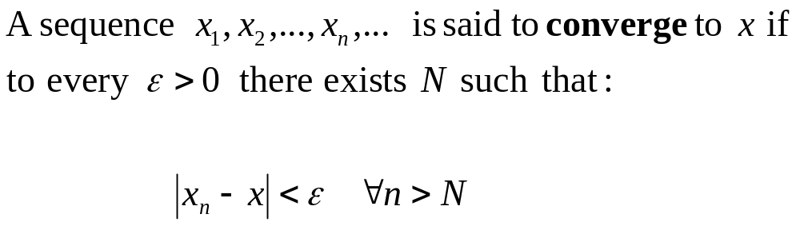
Convergence Notation
CISE301_Topic2
KFUPM

Slide 19
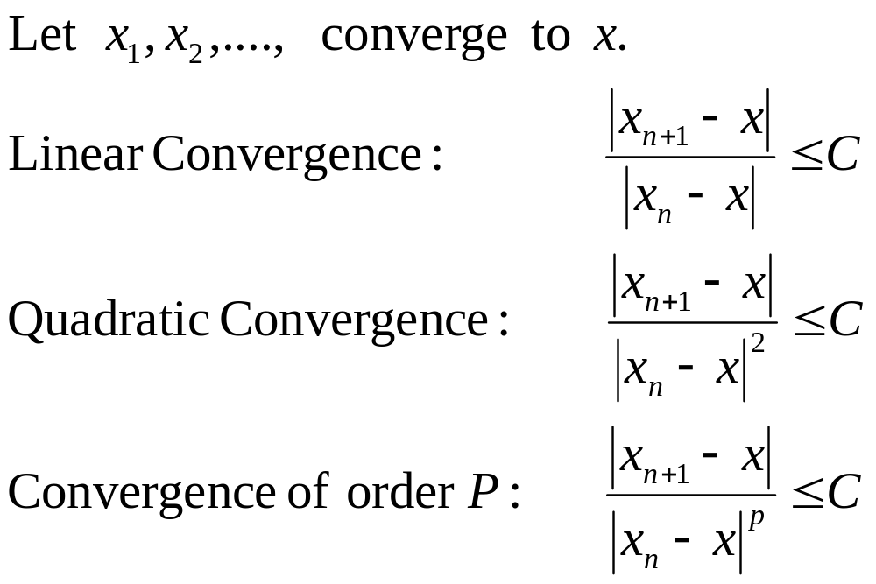
Convergence Notation
CISE301_Topic2
KFUPM

Slide 20
Speed of Convergence
We can compare different methods in terms of their convergence rate.
Quadratic convergence is faster than linear convergence.
A method with convergence order q converges faster than a method with convergence order p if q>p.
Methods of convergence order p>1 are said to have super linear convergence.
CISE301_Topic2
KFUPM

Slide 21
Lectures 6-7
Bisection Method
  The Bisection Algorithm
  Convergence Analysis of Bisection Method
  Examples
  Reading Assignment: Sections 5.1 and 5.2
CISE301_Topic2
KFUPM

Slide 22
Introduction
The Bisection method is one of the simplest methods to find a zero of a nonlinear function.
It is also called interval halving method.
To use the Bisection method, one needs an initial interval that is known to contain a zero of the function.
The method systematically reduces the interval. It does this by dividing the interval into two equal parts, performs a simple test and based on the result of the test, half of the interval is thrown away.
The procedure is repeated until the desired interval size is obtained.
CISE301_Topic2
KFUPM
Notes:
Convert to Speech:
The Bisection method is one of the simplest methods to find a zero of a nonlinear function.
The method is also called interval halving.
To use the Bisection method, you need an initial interval that is known to contain a zero of the given nonlinear function..
The method systematically reduces the interval.
Bi means two and bisection means divide into two. This is basically what the procedure is doing. It divides the interval into two equal parts, performs a simple test and based on the result of the test half of the interval is thrown away.
The remaining half is divided into two and the test is applied again and the procedure is repeated until the desired interval size is obtained.

Slide 23
Intermediate Value Theorem
Let f(x) be defined on the interval [a,b].
Intermediate value theorem:
if a function is continuous and f(a) and f(b) have different signs then the function has at least one zero in the interval [a,b].
f(a)
a
b
f(b)
CISE301_Topic2
KFUPM

Slide 24
Examples
If f(a) and f(b) have the same sign, the function may have an even number of real zeros or no real zeros in the interval [a, b].
Bisection method can not be used in these cases.
a
b
The function has four real zeros
a
b
The function has no real zeros
CISE301_Topic2
KFUPM

Slide 25
Two More Examples
If f(a) and f(b) have different signs, the function has at least one real zero.
Bisection method can be used to find one of the zeros.
a
b
The function has one real zero
a
b
The function has three real zeros
CISE301_Topic2
KFUPM
Notes:
Convert to Speech:
if the function is continuous and ef of ay and ef of be have different signs then the functions has at least one zero and the Bisection method can be applied to find a zero of the function.

Slide 26
Bisection Method
If the function is continuous on [a,b] and f(a) and f(b) have different signs, Bisection method obtains a new interval that is half of the current interval and the sign of the function at the end points of the interval are different.
This allows us to repeat the Bisection procedure to further reduce the size of the interval.
CISE301_Topic2
KFUPM
Notes:
Convert to Speech:
If the function is continuous on [a,b] and f(a) and f(b) have different signs, Bisection Method obtain a new interval that is half of the current interval and the sign of the function at the end points of the interval are different.
This allows us to repeat the Bisection procedure to further reduce the size of the interval.

Slide 27
Bisection Method
Assumptions:
Given an interval [a,b]
f(x) is continuous on [a,b]
f(a) and f(b) have opposite signs.
These assumptions ensure the existence of at least one zero in the interval [a,b] and the bisection method can be used to obtain a smaller interval that contains the zero.
CISE301_Topic2
KFUPM
Notes:
Convert to Speech:
The assumptions are:
Given an interval ae be
The function is continuous on the interal
And the values of ef of a and ef of be have different signs.
These assumptions ensures the existence of at least one zero in the interval [a,b] and the bisection method can be used to obtain a smaller interval that contains the zero.

Slide 28
Bisection Algorithm
Assumptions:
f(x) is continuous on [a,b]
f(a) f(b) < 0
Algorithm:
Loop
1. Compute the mid point c=(a+b)/2
2. Evaluate f(c)
3. If f(a) f(c) < 0 then new interval [a, c]
If f(a) f(c) > 0 then new interval [c, b]
End loop
f(a)
c
b
a
f(b)
CISE301_Topic2
KFUPM
Notes:
Convert to Speech:
Assuming that the function is continuous on ay be and ef of ay times ef of be is negative. The Bisection algorithm is an iterative procedure that obtains a new interval that is guaranteed to contain a zero of the function.
In each iteration, the first step is to obtain the middle point in the interval then evaluate the function at the mid point. In the third step the new interval is obtained based on the sign of ef of ay times ef of see. If this product is negative then the new interval is ay see otherwise the new interval is ay be.
And the procedure is repeated

Slide 29
Bisection Method
b0
a0
a1
a₂
CISE301_Topic2
KFUPM

Slide 30
Example
+ + -
+ - -
+ + -
CISE301_Topic2
KFUPM

Slide 31
Flow Chart of Bisection Method
Start: Given a,b and ε
u = f(a) ; v = f(b)
c = (a+b) /2 ; w = f(c)
no
yes
is
u w <0
no
is
(b-a) /2<ε
Stop
yes
b=c; v= w
a=c; u= w
CISE301_Topic2
KFUPM
Notes:
Convert to Speech:
A detailed flow chart of the Bisection algorithm is shown. The program starts with ay , be and epsilon.
Ae and be, the end points of the interval and epsilon is the accuracy level.
The function is evaluated at the end points and the values are stored in u and v.
In each iteration, the middle point c is computed and the function is evaluated and its value is stored in w.
If W times u is negative, That is ef of a times ef of c is negative then the new interval is ay see .
Otherwise the new interval is be see
A stopping criterion is used here. If the size of the interval is less than a desired accuracy level the algorithm is stopped, otherwise the procedure is repeated.

Slide 32
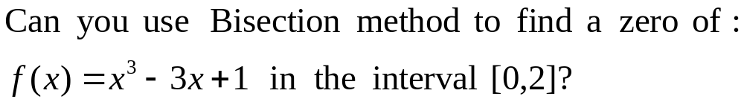
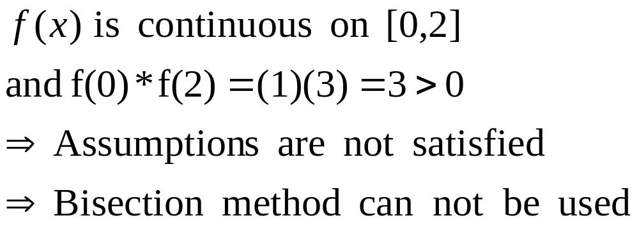
Example
Answer:
CISE301_Topic2
KFUPM
Notes:
Convert to Speech:
Can you use bisection method to find a zero of the function
Ex cube minus three x plus one over the interval zero to two.
Answer:
Ef of ex is a polynomial therefore it is continuous. Ef of zero times ef of 2 is equal to three which is positive.
The assumptions are violated and there fore we can not use the bisection method.

Slide 33
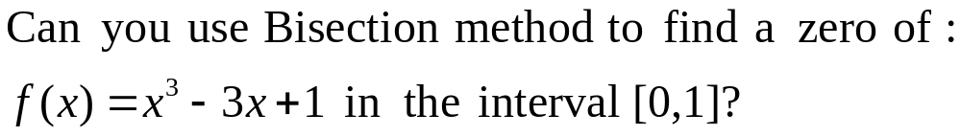
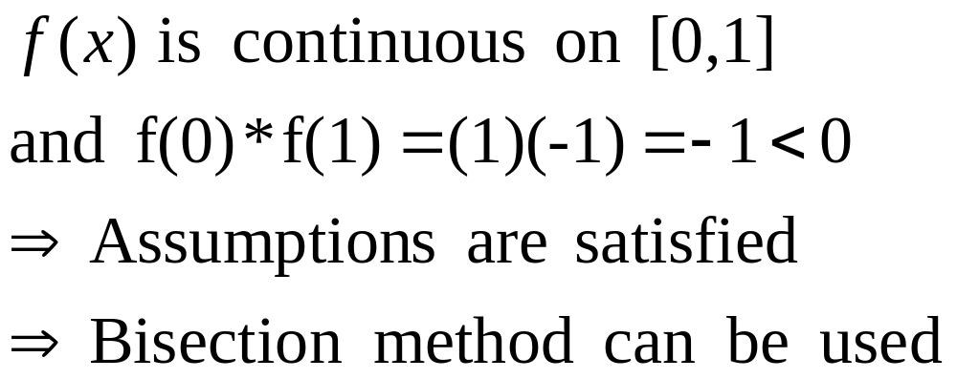
Example
Answer:
CISE301_Topic2
KFUPM
Notes:
Convert to Speech:
Can you use bisection method to find a zero of the function
Ex cube minus three x plus one over the interval zero to one.
Answer:
Ef of ex is a polynomial therefore it is continuous. Ef of zero times ef of 1 is equal to minus one.
All assumptions are satisfied and there fore we can use the bisection method.

Slide 34
Best Estimate and Error Level
Bisection method obtains an interval that is guaranteed to contain a zero of the function.
Questions:
What is the best estimate of the zero of f(x)?
What is the error level in the obtained estimate?
CISE301_Topic2
KFUPM
Notes:
Convert to Speech:
Best Estimate and error level.
The Bisection method obtains an interval that is grunted to contain a zero of the function. If we want to obtain a single point as the best estimate of the zero of the function, what is that value? and what is the level of the error when this estimate is used?

Slide 35
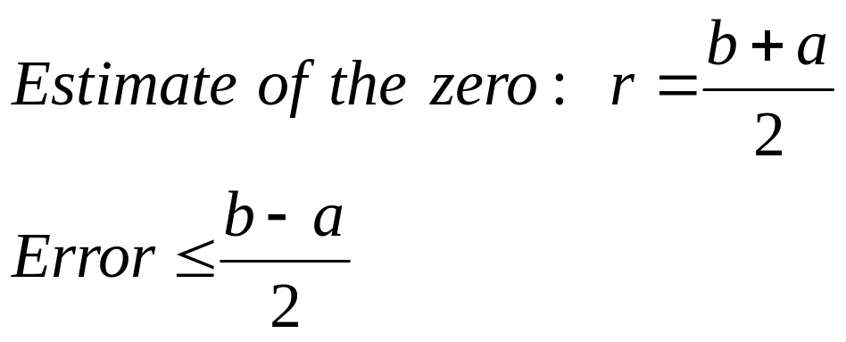
Best Estimate and Error Level
The best estimate of the zero of the function f(x) after the first iteration of the Bisection method is the mid point of the initial interval:
CISE301_Topic2
KFUPM
Notes:
Convert to Speech:
Different approaches in selecting the solution can be used. The approach that will be used here is the middle point of the final interval. Doing this we guarantee that the error in estimating the zero of ef of ex is less than or equal to the half of the size of the final interval.

Slide 36
Stopping Criteria
Two common stopping criteria
Stop after a fixed number of iterations
Stop when the absolute error is less than a specified value
How are these criteria related?
CISE301_Topic2
KFUPM
Notes:
Convert to Speech:
Two commonly used way to stop the Bisection method.
Stop after a given fixed number of iterations
Or
Stop when the error is less than a specified value.
In fact if one is given the initial interval and the error level, the number of iterations needed to achieve this accuracy can be calculated easily. Similarly if the initial interval and the number of iterations are given then one can obtain an upper bound on the resulted error.

Slide 37
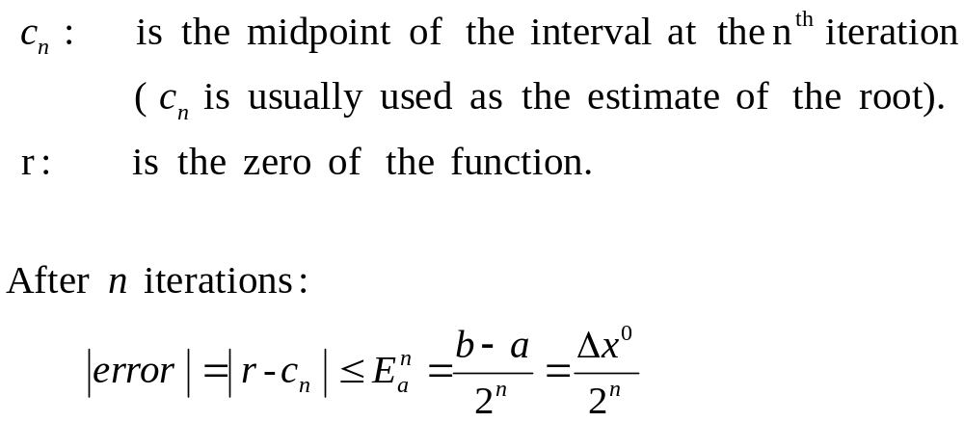
Stopping Criteria
CISE301_Topic2
KFUPM
Notes:
The above criteria are related. Fixing the number of iteration, you can get a formula relating the error to the number of iterations.
Let c en be the midpoint of the interval after n iterations and let r be the zero of the function
The error after n iterations is less than b minus a over two to the power n.

Slide 38
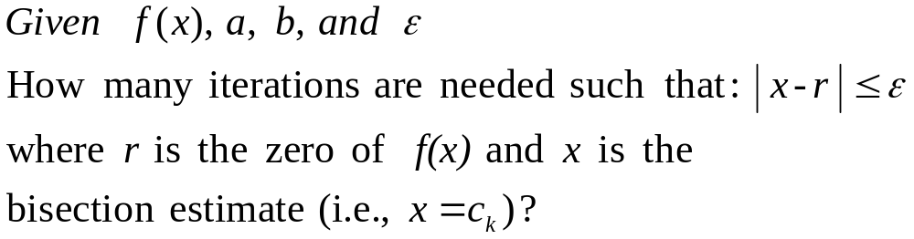
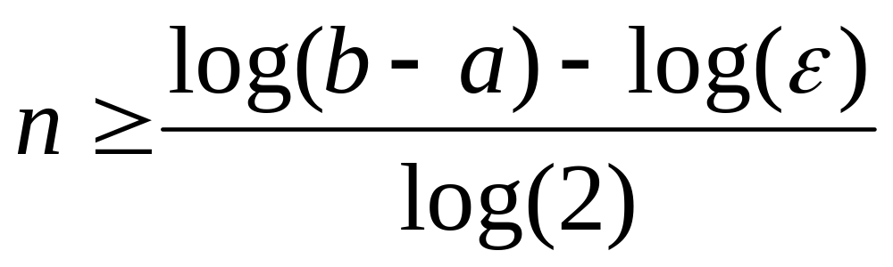
Convergence Analysis
CISE301_Topic2
KFUPM
Notes:
Given ef of x , a, b and epsilon
We need to determine the number of iterations such that the absolute of r minus x is less than epsilon.
R here is the zero of the function and x is the bisection estimate. That is x equals see kay
The number of iterations n is given by the equation
N is greater than or equal to log of b minus a minus log of epsilon all over log of two.

Slide 39
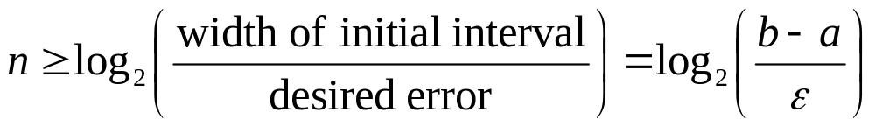
Convergence Analysis – Alternative Form
CISE301_Topic2
KFUPM
Notes:
An alternative formula is given here
The number of iterations is greater than or equal to log to base two of the ratio of the width of the initial interval to the desired error.

Slide 40
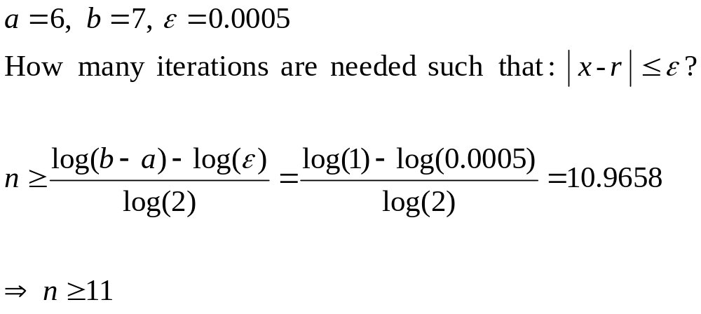
Example
CISE301_Topic2
KFUPM
Notes:
In this example the formula for the number of iterations is used to answer the question
How many iterations of the bisection method is needed so that the error is less than epsilon
Here ay is 6, bee is 7 and epsilon is 0.0005
Direct substitution results in the inequality n must be greater than or equal to eleven.

Slide 41
Example
Use Bisection method to find a root of the equation x = cos (x) with absolute error <0.02
(assume the initial interval [0.5, 0.9])
Question 1: What is f (x) ?
Question 2: Are the assumptions satisfied ?
Question 3: How many iterations are needed ?
Question 4: How to compute the new estimate ?
CISE301_Topic2
KFUPM
Notes:
to solve this problem we need to answer four questions
What is f (x) in case it is not available directly.
Are the assumptions satisfied ?
How many iterations are needed to achieve the desired accuracy?
And finally
How to compute the new estimate ?

Slide 42
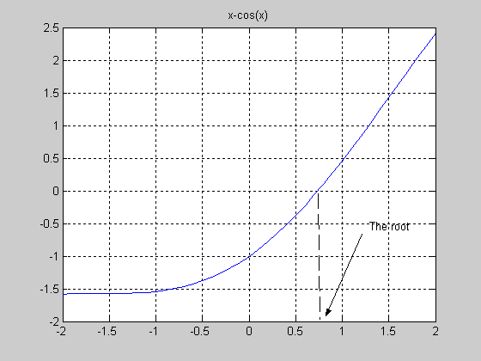
CISE301_Topic2
KFUPM
Notes:
This graph shows a plot of the function x minus cosine ex
The zero of the function is approximatley zero point seven and the interval zero pont five to zero point nine contains the zero for sure.

Slide 43
Bisection Method
Initial Interval
f(a)=-0.3776 f(b) =0.2784
Error < 0.2
a =0.5 c= 0.7 b= 0.9
CISE301_Topic2
KFUPM

Slide 44
Bisection Method
-0.3776 -0.0648 0.2784
Error < 0.1
0.5 0.7 0.9
-0.0648 0.1033 0.2784
Error < 0.05
0.7 0.8 0.9
CISE301_Topic2
KFUPM

Slide 45
Bisection Method
-0.0648 0.0183 0.1033
Error < 0.025
0.7 0.75 0.8
-0.0648 -0.0235 0.0183
Error < .0125
0.70 0.725 0.75
CISE301_Topic2
KFUPM

Slide 46
Summary
Initial interval containing the root: [0.5,0.9]
After 5 iterations:
  Interval containing the root: [0.725, 0.75]
  Best estimate of the root is 0.7375
  | Error | < 0.0125
CISE301_Topic2
KFUPM

Slide 47
A Matlab Program of Bisection Method
a=.5; b=.9;
u=a-cos(a);
v=b-cos(b);
for i=1:5
c=(a+b)/2
fc=c-cos(c)
if u*fc<0
b=c ; v=fc;
else
a=c; u=fc;
end
end
c =
0.7000
fc =
-0.0648
c =
0.8000
fc =
0.1033
c =
0.7500
fc =
0.0183
c =
0.7250
fc =
-0.0235
CISE301_Topic2
KFUPM
Notes:
This a simple MATLAB implementation of the Bisection algorithm
The first line defines the end points of the interval
In the following two lines the value of the function at the end points are evaluated
The fourth line is the start of the loop and five iterations of bisection method will be used.
In each iteration , the middle point is calculated and the value of the function at the middle point is evaluated.
Followed by a test to determine the new interval.
The procedure is repeated five times

Slide 48
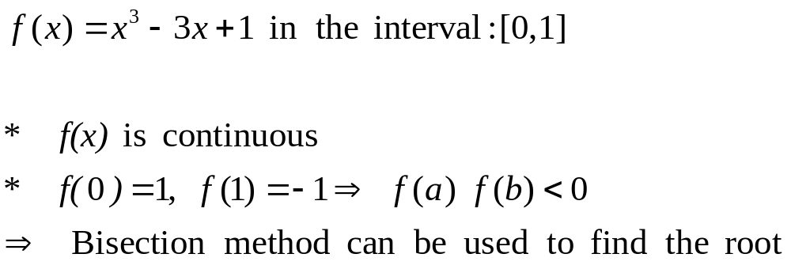
Example
Find the root of:
CISE301_Topic2
KFUPM

Slide 49
Example
Iteration | a | b | c= (a+b) 2 | f(c) | (b-a) 2
1 | 0 | 1 | 0.5 | -0.375 | 0.5
2 | 0 | 0.5 | 0.25 | 0.266 | 0.25
3 | 0.25 | 0.5 | .375 | -7.23E-3 | 0.125
4 | 0.25 | 0.375 | 0.3125 | 9.30E-2 | 0.0625
5 | 0.3125 | 0.375 | 0.34375 | 9.37E-3 | 0.03125
CISE301_Topic2
KFUPM

Slide 50
Bisection Method
Advantages
Simple and easy to implement
One function evaluation per iteration
The size of the interval containing the zero is reduced by 50% after each iteration
The number of iterations can be determined a priori
No knowledge of the derivative is needed
The function does not have to be differentiable
Disadvantage
Slow to converge
Good intermediate approximations may be discarded
CISE301_Topic2
KFUPM

Slide 51
Lecture 8-9
Newton-Raphson Method
  Assumptions
  Interpretation
  Examples
  Convergence Analysis
CISE301_Topic2
KFUPM

Slide 52
Newton-Raphson Method
(Also known as Newton’s Method)
Given an initial guess of the root x₀, Newton-Raphson method uses information about the function and its derivative at that point to find a better guess of the root.
Assumptions:
  f(x) is continuous and the first derivative is known
  An initial guess x₀ such that f’(x₀)≠0 is given
CISE301_Topic2
KFUPM

Slide 53
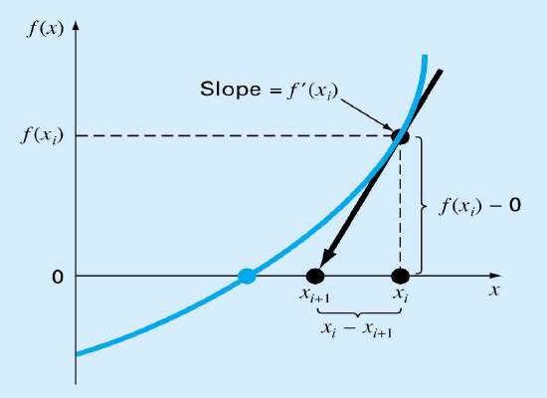
Newton Raphson Method
- Graphical Depiction -
If the initial guess at the root is x_{i}, then a tangent to the function of x_{i} that is f’(x_{i}) is extrapolated down to the x-axis to provide an estimate of the root at x_{i} +1.
CISE301_Topic2
KFUPM

Slide 54
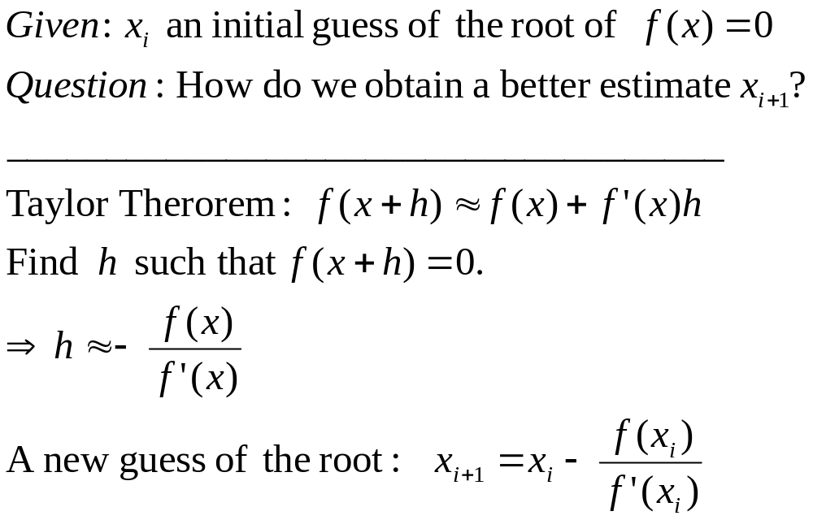

Derivation of Newton’s Method
CISE301_Topic2
KFUPM

Slide 55
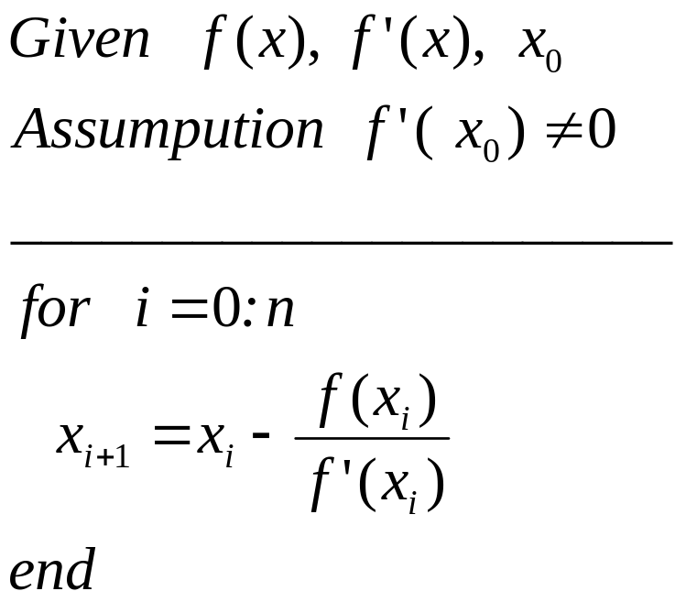
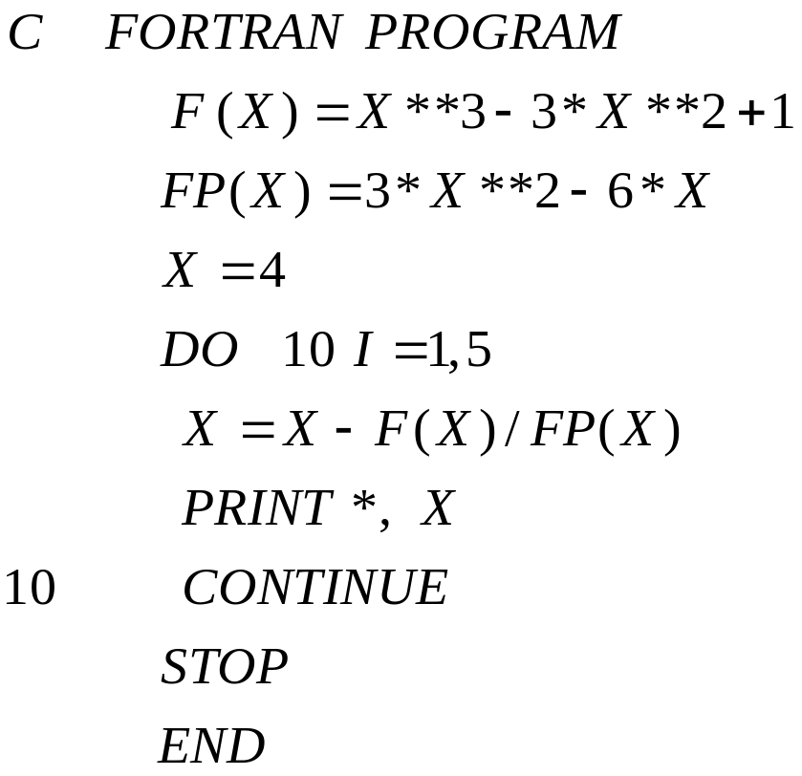
Newton’s Method
CISE301_Topic2
KFUPM

Slide 56

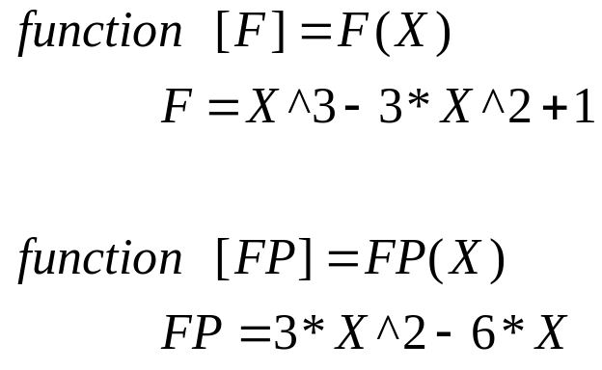
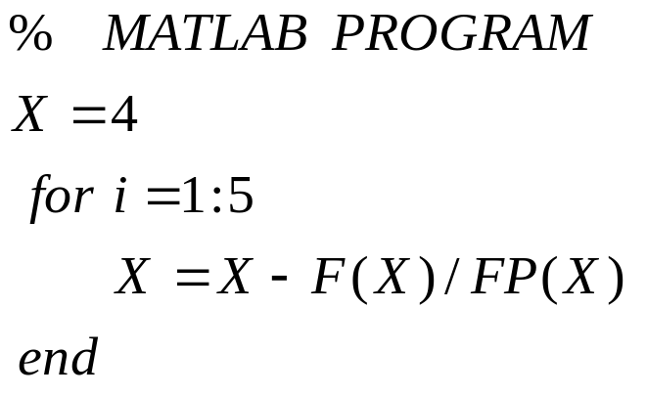
Newton’s Method
F.m
FP.m
CISE301_Topic2
KFUPM

Slide 57
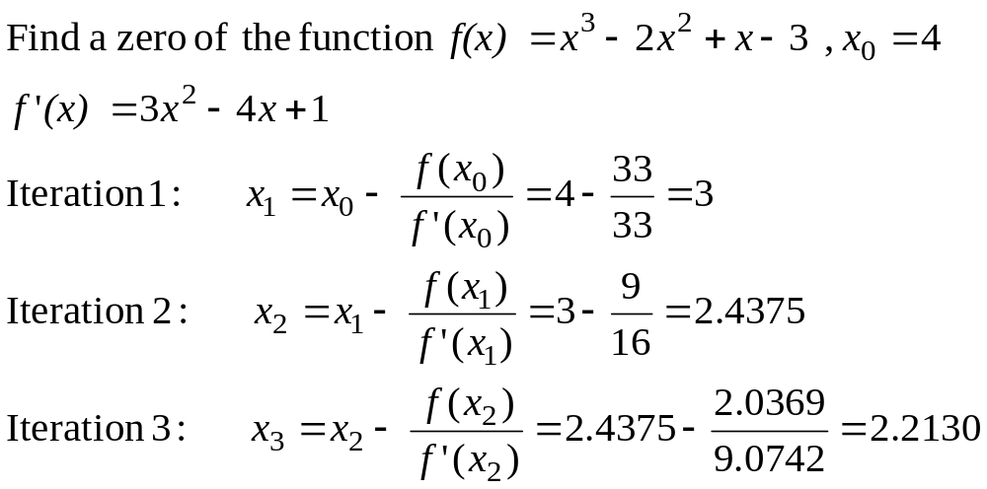
Example
CISE301_Topic2
KFUPM

Slide 58
Example
k (Iteration) | x_{k} | f(x_{k}) | f’(x_{k}) | x_{k+1} | |x_{k+1} –x_{k}|
0 | 4 | 33 | 33 | 3 | 1
1 | 3 | 9 | 16 | 2.4375 | 0.5625
2 | 2.4375 | 2.0369 | 9.0742 | 2.2130 | 0.2245
3 | 2.2130 | 0.2564 | 6.8404 | 2.1756 | 0.0384
4 | 2.1756 | 0.0065 | 6.4969 | 2.1746 | 0.0010
CISE301_Topic2
KFUPM

Slide 59
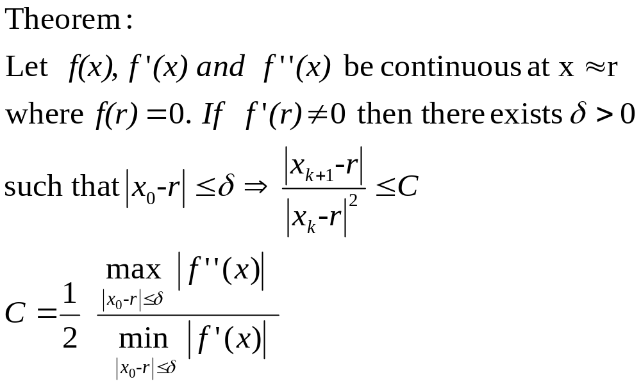
Convergence Analysis
CISE301_Topic2
KFUPM

Slide 60
Convergence Analysis
Remarks
When the guess is close enough to a simple root of the function then Newton’s method is guaranteed to converge quadratically.
Quadratic convergence means that the number of correct digits is nearly doubled at each iteration.
CISE301_Topic2
KFUPM

Slide 61
Problems with Newton’s Method
If the initial guess of the root is far from
the root the method may not converge.
Newton’s method converges linearly near
multiple zeros { f(r) = f’(r) =0 }. In such a
case, modified algorithms can be used to
regain the quadratic convergence.
CISE301_Topic2
KFUPM

Slide 62

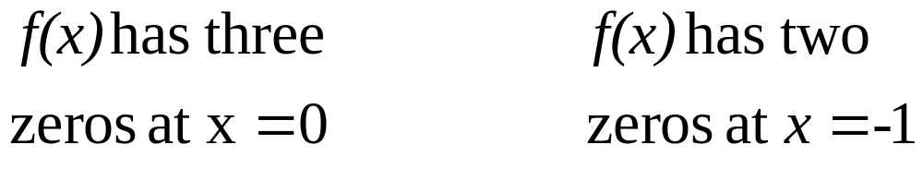
Multiple Roots
CISE301_Topic2
KFUPM

Slide 63
Problems with Newton’s Method
- Runaway -
x₀
x₁
The estimates of the root is going away from the root.
CISE301_Topic2
KFUPM

Slide 64
Problems with Newton’s Method
- Flat Spot -
x₀
The value of f’(x) is zero, the algorithm fails.
If f ’(x) is very small then x₁ will be very far from x₀.
CISE301_Topic2
KFUPM

Slide 65
Problems with Newton’s Method
- Cycle -
x₁=x₃=x₅
x₀=x₂=x₄
The algorithm cycles between two values x₀ and x₁
CISE301_Topic2
KFUPM

Slide 66
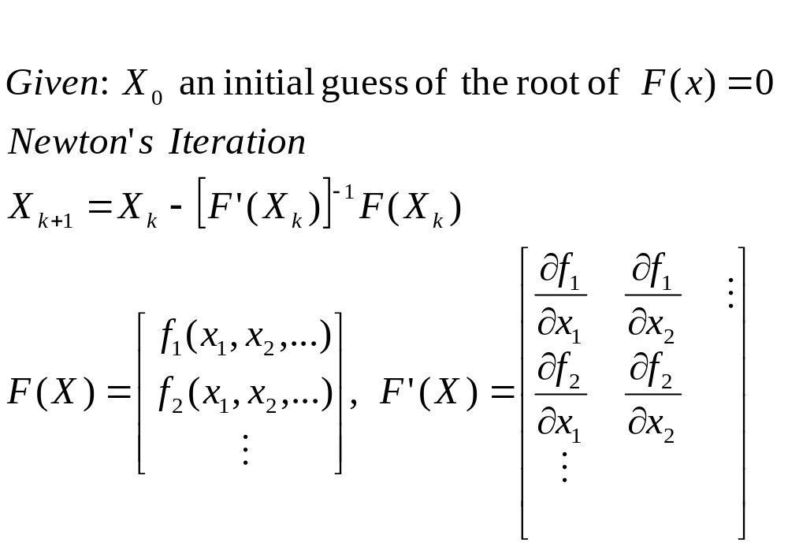
Newton’s Method for Systems of Non Linear Equations
CISE301_Topic2
KFUPM

Slide 67
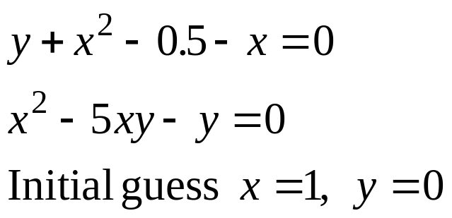
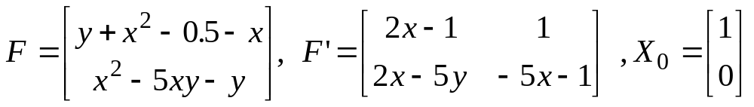
Example
Solve the following system of equations:
CISE301_Topic2
KFUPM

Slide 68
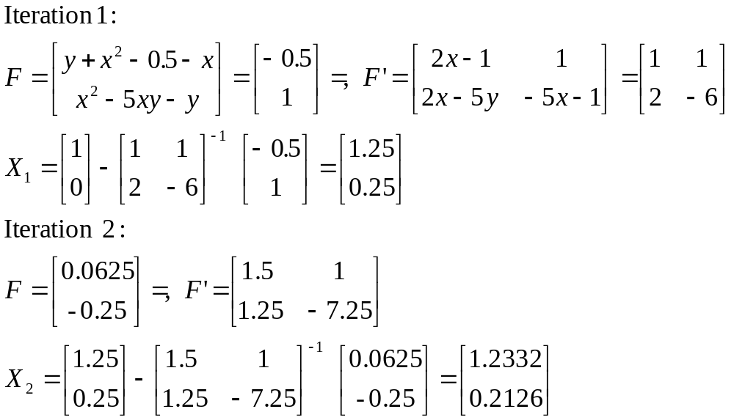
Solution Using Newton’s Method
CISE301_Topic2
KFUPM

Slide 69
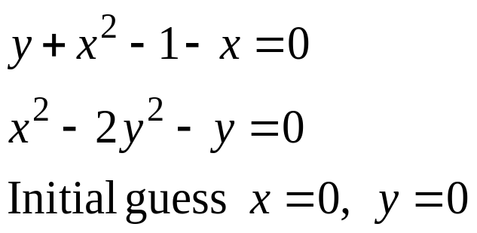
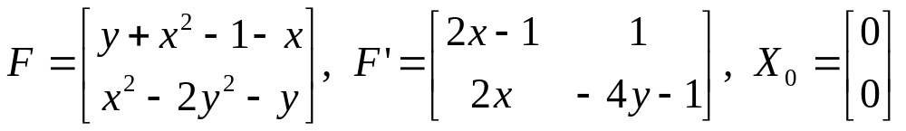
Example
Try this
Solve the following system of equations:
CISE301_Topic2
KFUPM

Slide 70
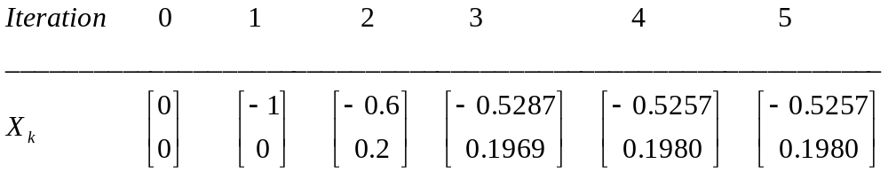
Example
Solution
CISE301_Topic2
KFUPM

Slide 71
Lectures 10
Secant Method
Secant Method
Examples
Convergence Analysis
CISE301_Topic2
KFUPM

Slide 72
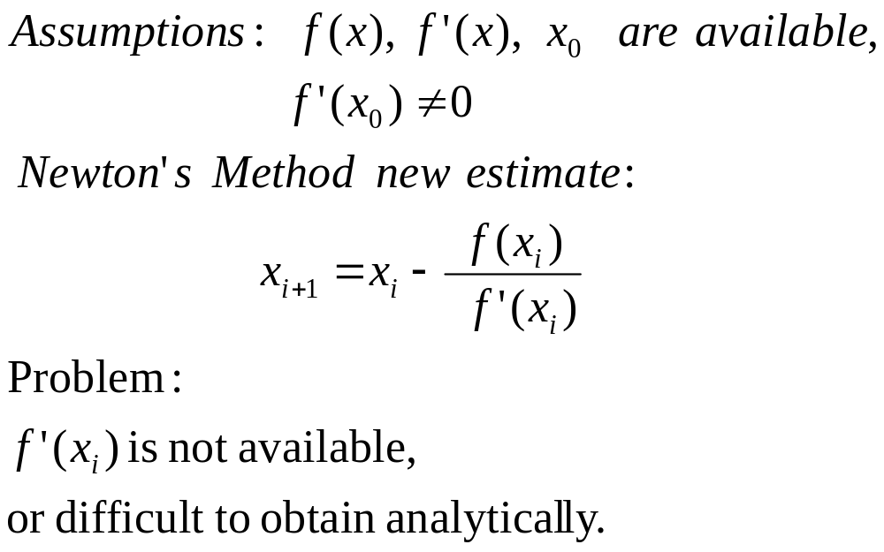
Newton’s Method (Review)
CISE301_Topic2
KFUPM

Slide 73
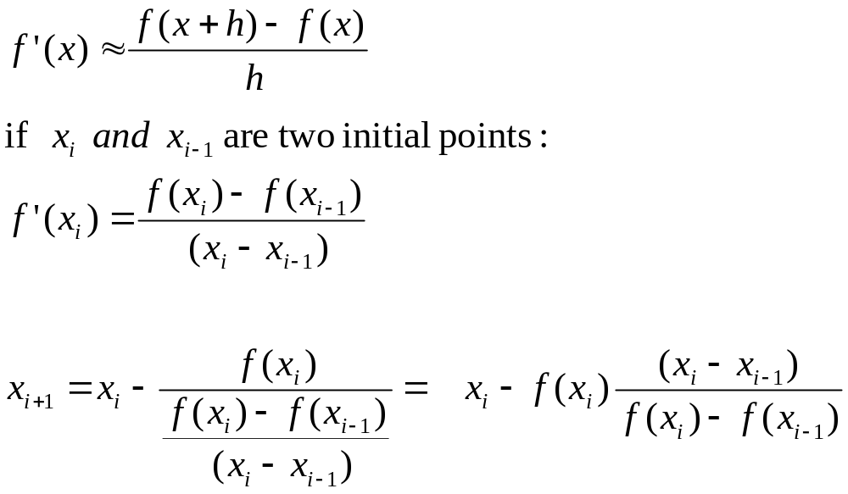
Secant Method
CISE301_Topic2
KFUPM

Slide 74
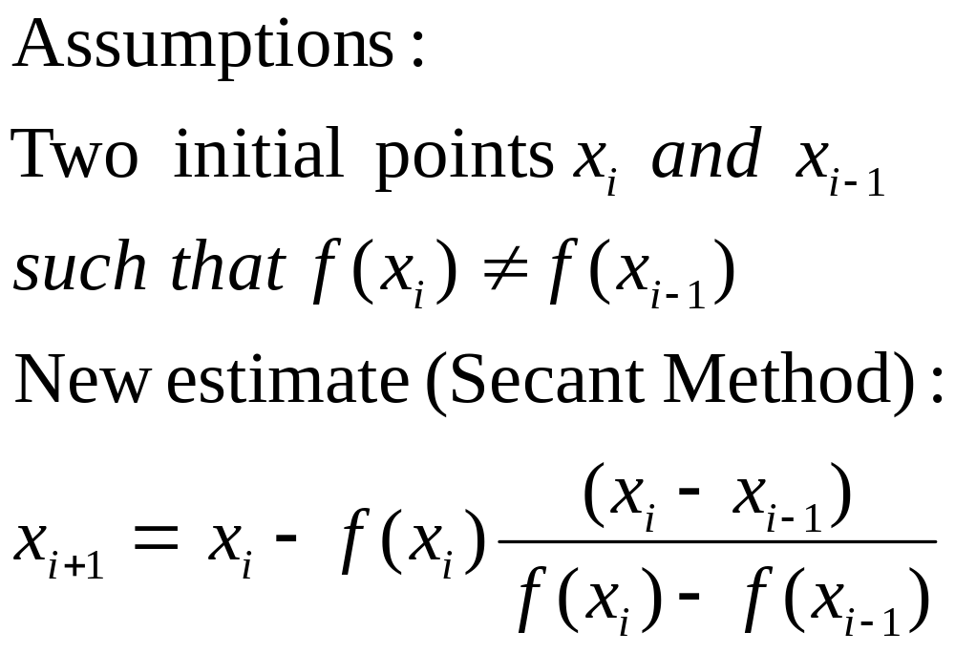
Secant Method
CISE301_Topic2
KFUPM

Slide 75
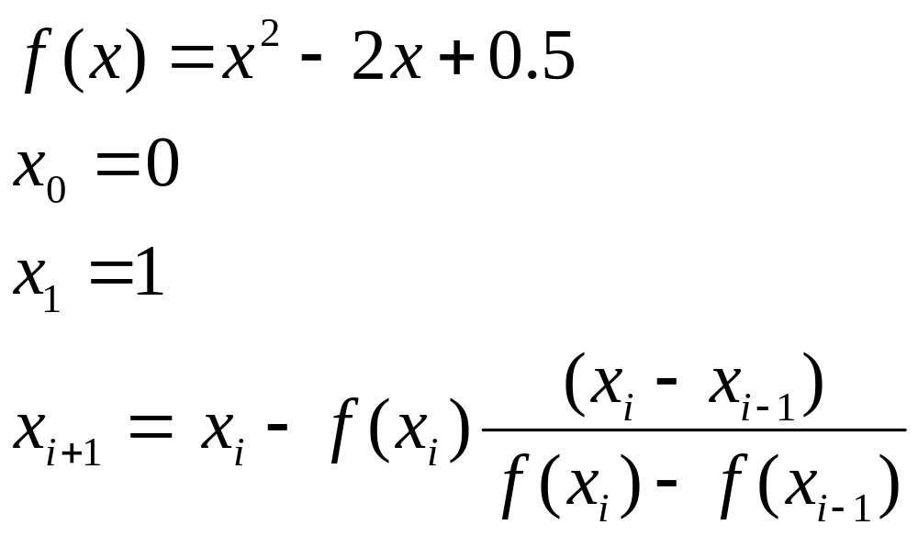
Secant Method
CISE301_Topic2
KFUPM

Slide 76
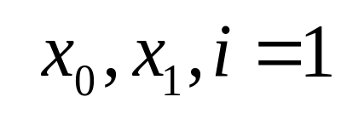
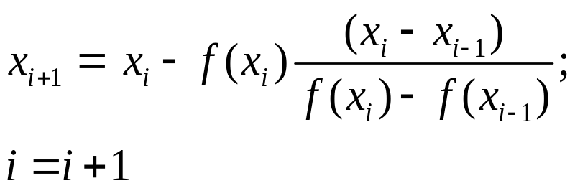
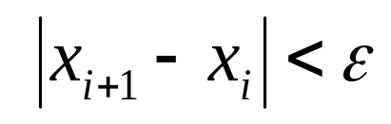
Secant Method - Flowchart
NO
Yes
Stop
CISE301_Topic2
KFUPM

Slide 77
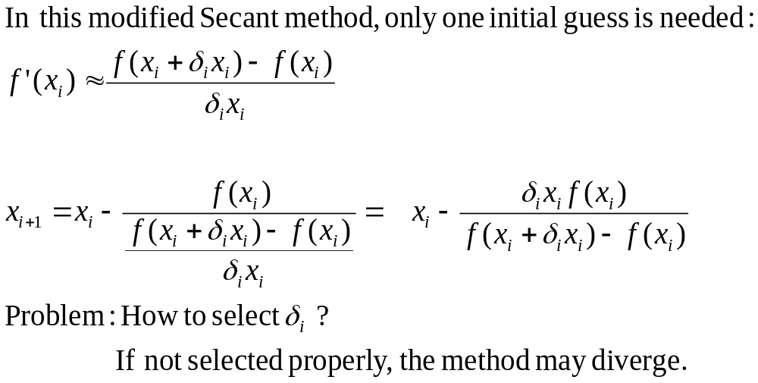
Modified Secant Method
CISE301_Topic2
KFUPM

Slide 78
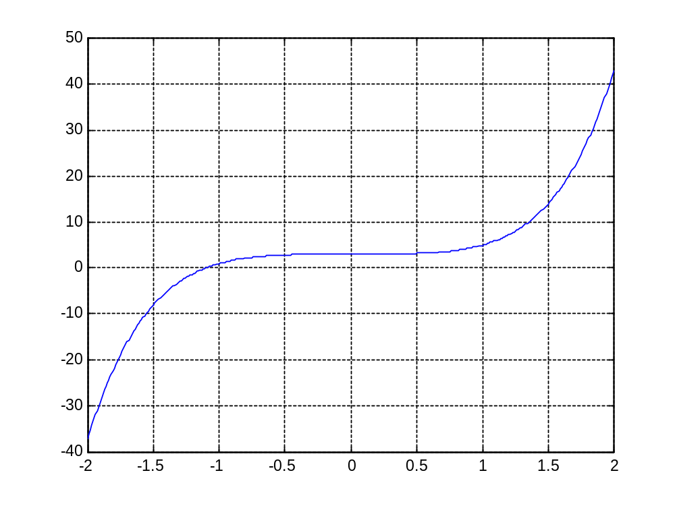
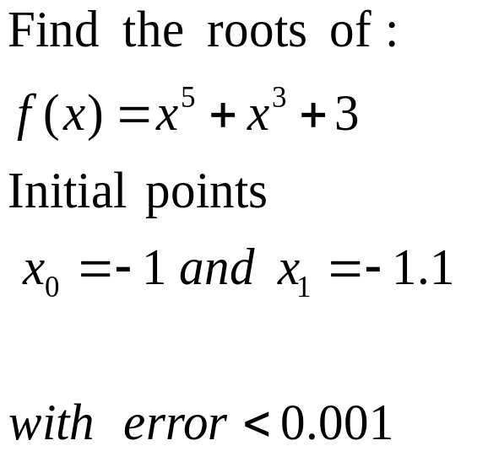
Example
CISE301_Topic2
KFUPM

Slide 79
Example
x(i) | f(x(i)) | x(i+1) | |x(i+1)-x(i)|
-1.0000 | 1.0000 | -1.1000 | 0.1000
-1.1000 | 0.0585 | -1.1062 | 0. 0062
-1.1062 | 0.0102 | -1.1052 | 0.0009
-1.1052 | 0.0001 | -1.1052 | 0.0000
CISE301_Topic2
KFUPM

Slide 80

Convergence Analysis
The rate of convergence of the Secant method is super linear:
It is better than Bisection method but not as good as Newton’s method.
CISE301_Topic2
KFUPM

Slide 81
Lectures 11
Comparison of Root
Finding Methods
Advantages/disadvantages
Examples
CISE301_Topic2
KFUPM

Slide 82
Summary
Method | Pros | Cons
Bisection | - Easy, Reliable, Convergent - One function evaluation per iteration - No knowledge of derivative is needed | - Slow - Needs an interval [a,b] containing the root, i.e., f(a)f(b)<0
Newton | - Fast (if near the root) - Two function evaluations per iteration | - May diverge - Needs derivative and an initial guess x0 such that f’(x0) is nonzero
Secant | - Fast (slower than Newton) - One function evaluation per iteration - No knowledge of derivative is needed | - May diverge - Needs two initial points guess x0, x1 such that f(x0)- f(x1) is nonzero
CISE301_Topic2
KFUPM

Slide 83

Example
CISE301_Topic2
KFUPM

Slide 84
Solution
_______________________________
k x_{k} f(x_{k})
_______________________________
0 1.0000 -1.0000
1 1.5000 8.8906
2 1.0506 -0.7062
3 1.0836 -0.4645
4 1.1472 0.1321
5 1.1331 -0.0165
6 1.1347 -0.0005
CISE301_Topic2
KFUPM

Slide 85

Example
CISE301_Topic2
KFUPM

Slide 86
Five Iterations of the Solution
k x_{k} f(x_{k}) f’(x_{k}) ERROR
______________________________________
0 1.0000 -1.0000 2.0000
1 1.5000 0.8750 5.7500 0.1522
2 1.3478 0.1007 4.4499 0.0226
3 1.3252 0.0021 4.2685 0.0005
4 1.3247 0.0000 4.2646 0.0000
5 1.3247 0.0000 4.2646 0.0000
CISE301_Topic2
KFUPM

Slide 87

Example
CISE301_Topic2
KFUPM

Slide 88

Example
CISE301_Topic2
KFUPM

Slide 89
Example
Estimates of the root of: x-cos(x)=0.
0.60000000000000 Initial guess
0.74401731944598 1 correct digit
0.73909047688624 4 correct digits
0.73908513322147 10 correct digits
0.73908513321516 14 correct digits
CISE301_Topic2
KFUPM

Slide 90
Example
In estimating the root of: x-cos(x)=0, to get more than 13 correct digits:
4 iterations of Newton (x₀=0.8)
43 iterations of Bisection method (initial
interval [0.6, 0.8])
5 iterations of Secant method
( x₀=0.6, x₁=0.8)
CISE301_Topic2
KFUPM

